Slide 1



Strategic Planning
What Game Are We Playing and How Are We Going to Win?
www.leanhorizons.com

Slide 2
Introduction
Anatomy of a Strategic Plan
Common Issues with Strategic Planning
Final Thoughts
Agenda

Slide 3

What is Strategy?
First, let’s consider what Strategy IS NOT!
“Operational effectiveness is not strategy.”
- Michael E. Porter

Slide 4

However…
Operational Excellence (in terms of SQDC*) enables superior execution of the necessary operational imperatives in which to implement strategy.
“You must earn the right to grow.”
- Danaher Strategic Policy Statement
* Safety, Quality, Delivery, Cost

Slide 5

Where is Your Company?
Typical Maturity Timeline - With Aggressive Adoption of Lean
FOCUS:
OPERATIONS
(SQDC)
FOCUS
PROFITABLE
GROWTH
FOCUS:
----- HYBRID -----
0 - 2 Years
1 - 3 Years
3+ Years
Are you positioned for GROWTH?
Notes:
DO: Use this analogy and stress the common error that many companies make during Strategic Deployment.

Slide 6
Strategy Defined
Strategy is where we roadmap sustainable competitive advantage for profitable, long-term growth, and we must answer the question…
“What game are we playing and how are we going to win?”

Slide 7
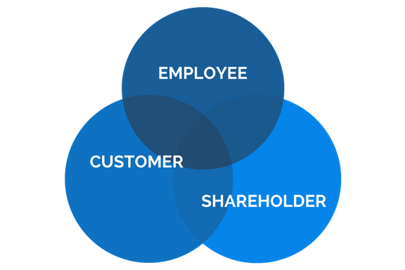
But Who Defines Winning?
Winning is defined by your key stakeholders
Cannot be a Zero-Sum game
All stakeholders* must win!
* Other Stakeholders include Community, Society, Environment, Suppliers, Competition

Slide 8

Strategic Plan Relationships
Strategic Planning is NOT a budget or financial exercise!
Do not confuse financial planning with strategic planning!
Strategic Plan
Strategy Deployment
Product Plan
Financial Plan

Slide 9

Strategic Planning Roadmap
Collect Data per Data Request
Organize & Analyze Data
Determine ”Voice of the Data”
Identify Potential Strategic Stretch
Objectives
Start
A
1
2
3
4
NO
Prioritize & Select Stretch Objectives
Deselect Stretch Objectives
Appraise Benefits of Stretch Objectives
Meet Stakeholder Expectations?
A
YES
B
5
6
7
Determine PRELIMINARY Hoshin AIPs and Targets
Finalize Strategic Plan Presentation
Plan for Hoshin
Workshops (People, timing, etc.)
B
END
8
9
10

Slide 10
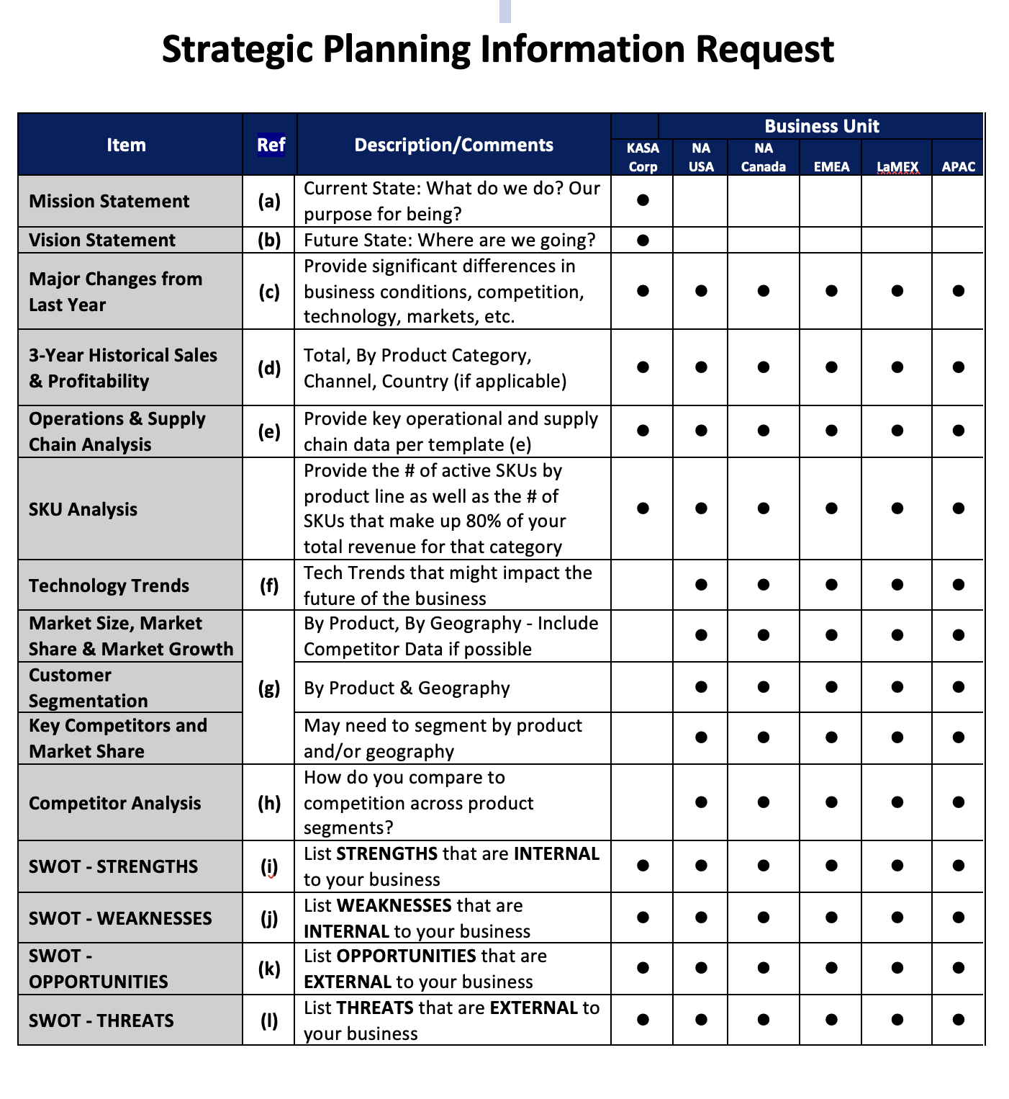
The Data Request
Data collection systems required to collect strategic data on an ongoing basis.

Slide 11
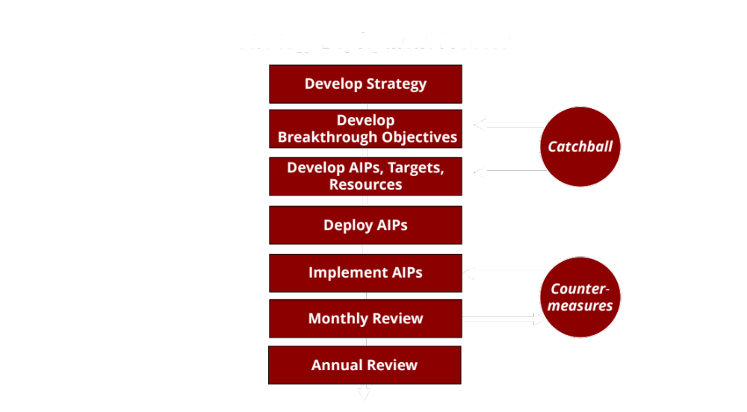
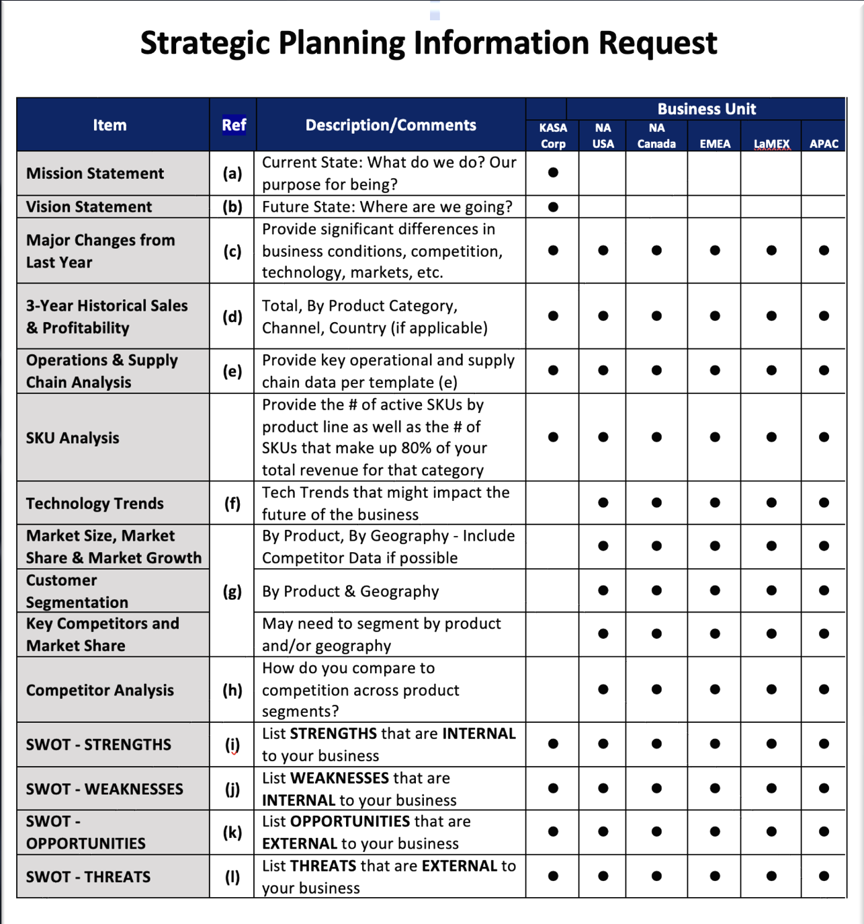
Strategic Planning is NOT an Event
- It’s a Continuous Process
Confirm/Adjust Strategy
Strategic Scan Considerations
SD Performance +
Market
Customer
Competition
Technology
Regulations
Environment
Supply Chain
Economy
Quarterly Checkpoint

Slide 12
Introduction
Anatomy of a Strategic Plan
Common Issues with Strategic Planning
Final Thoughts
Agenda

Slide 13
Major Strategic Plan Components
4
Voice of the Customer
1
Mission Statement
5
SWOT Analysis
2
Vision Statement
6
3 - Year Sales History
3
Major Changes from Last Year
7
Strategic Breakthrough Objectives

Slide 14
Supporting Data and Analysis
Operations & Supply Chain Analysis
11
Technological Trends
8
9
12
SKU Analysis
Market Analysis
10
Competitive Analysis
13
Risk Analysis
14
Human Capital
15
Financial Summary

Slide 15
1
Mission Statement
Defined: Current State - What do we do? Our purpose for being?
Coca-Cola: “To craft the brands and choice of drinks that people love, to refresh them in body & spirit.”
Starbucks: “To inspire and nurture the human spirit – one person, one cup, and one neighborhood at a time.”

Slide 16
2
Vision Statement
Defined: Future State - Where are we going?
Amazon: “Our vision is to be earth's most customer-centric company; to build a place where people can come to find and discover anything they might want to buy online.”
Tesla: “To create the most compelling car company of the 21st century by driving the world’s transition to electric vehicles.”

Slide 17
3
Major Changes from Last Year
Defined: Provide significant differences in business conditions, competition, technology, markets, etc.
Kaizen improvements in our New Product Development process (time to market from 48 months to 12 months) will provide a significant competitive advantage with new product entries.
New European environmental regulations will require that we redesign our packaging to be eco-friendly, consistent with the new regulations.

Slide 18
4
Voice of the Customer
Quality
Product or Service Features, Attributes, Dimensions, Characteristics Relating to the Function of the Product or Service, Reliability, Availability, Effectiveness, Recovery, Customer Returns, Defects, Rework or Scrap
The challenge is to understand how your customers, stakeholders, process owner, etc. define and prioritize the various needs and expectations they have of your products and services.
Cost
Process Cost Efficiency, Prices to Consumer (Initial Plus Life Cycle), Repair Costs, Purchase Price, Financing Terms, Depreciation, Residual Value, Raw Material, Energy Efficiency
Speed
Lead Times, Delivery Times, Turnaround Times, Setup Times, Delays, Up Time, Equipment Availability, Rolling Speed, Flexibility
Service
and Safety
Environment, Health and Safety Policy, Service Requirements, After-Purchase Reliability, Parts Availability, Service, Warranties, Maintainability, Customer-Required Maintenance, Product Liability, Product/Service Safety, Recordable Injuries, Lost Time, Environmental Incidents
Corporate
Responsibility
Ethical Business Conduct, Business Risk Management, Environment, Health and Safety Policy, Code of Conduct

Slide 19


“Do you REALLY know the expectations of your customer?”
100% On-time Delivery to Request Date
ZERO Defects
ZERO Field Warranty
Jake Brake’s Performance
All of the above plus:
Consistent label placement
Timely responses
Dunnage removal
HINO’s Expectations
We never asked!
Hino’s Supplier Rating of JAKE Brake: #106 of 110 Engine Suppliers!

Slide 20
5
SWOT Analysis
S
W
Internal to
the Business:
Strengths
Weaknesses
O
T
External to
the Business:
Opportunities
Threats

Slide 21
5
SWOT Analysis - Examples
S
W
Strengths
Weaknesses
INTERNAL TO THE BUSINESS
INTERNAL TO THE BUSINESS
Our salesforce is highly experienced and have ensconced customer relationships.
Our New Product Development “time to market” lags competition by 75%.

Slide 22
5
SWOT Analysis - Examples
O
T
Opportunities
Threats
EXTERNAL TO THE BUSINESS
EXTERNAL TO THE BUSINESS
Espresso making is intimidating for the home user, and simple, less intimidating, innovative, proprietary in-home espresso products could revolutionize the home-based espresso market.
The conversion from fossil fueled vehicles to electric automobiles will challenge our traditional gas-powered vehicle product platform.

Slide 23
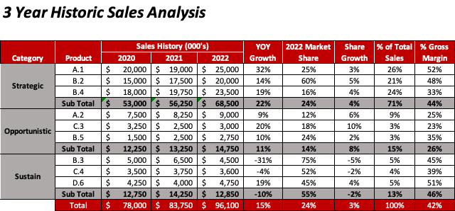
6
3 - Year Sales History
Strategic: Products that will drive sustainable, profitable share-growth
Opportunistic: Early stage products or markets
Sustain: Legacy products and/or markets

Slide 24

6
3 - Year Sales History
Key Questions to Consider:
Where are share growth opportunities?
What is the likelihood of Opportunistic Products revenue projection?
Where are growth opportunities to take market share?
Do you understand why key product categories have declined?
Did price increases distort your true growth picture?

Slide 25
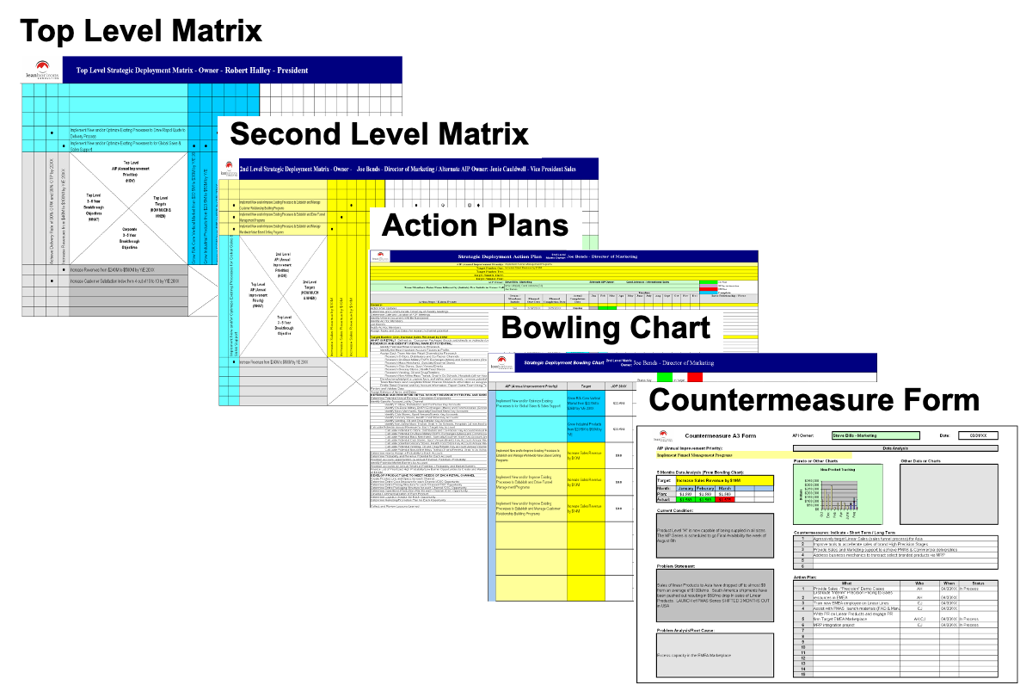
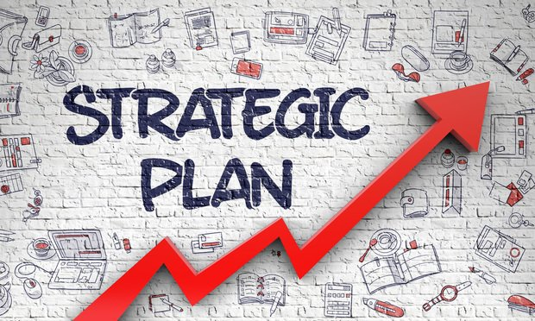
7
Strategic Breakthrough Objectives & Likely Strategies
Relationship of Strategic Planning to Strategy Deployment
Strategy Deployment is a Means to Make Your Strategic Plan a Reality
STRATEGIC PLANNING
STRATEGY DEPLOYMENT
STRATEGIC OBJECTIVES & LIKELY STRATEGIES
Do not confuse Strategic Planning with Strategy Deployment!

Slide 26

7
Strategic Breakthrough Objectives & Likely Strategies
Strategic Breakthrough Objective:
Increase Market Share from 20% to 55% by 12/31/XXXX
To Be Confirmed & Refined by the Strategic Deployment Team
Pro Forma Strategic Initiatives
Market Development
Process Improvement
People Development
Product Development
Develop Market for High Speed Controllers
Redesign New Product Development Process to Meet Customer Needs
Develop Monolithic Engineering Development Program
Develop High Speed Controller Design Process Product Offerings
SD AIP
$40 million revenue with 45% Gross Margin by 12/31/XX
Reduce N.P.D. Lead-Time from 48 Months to 6 Months by 12/31/XX
Improve Monolithic Engineering Density from 15% to 50% by 12/31/XX
Improve Vitality Index from 30% to 55% by 12/31/XX
SD TTI
SD TTI = Targets To Improve SD AIP = Annual Improvement Priorities

Slide 27
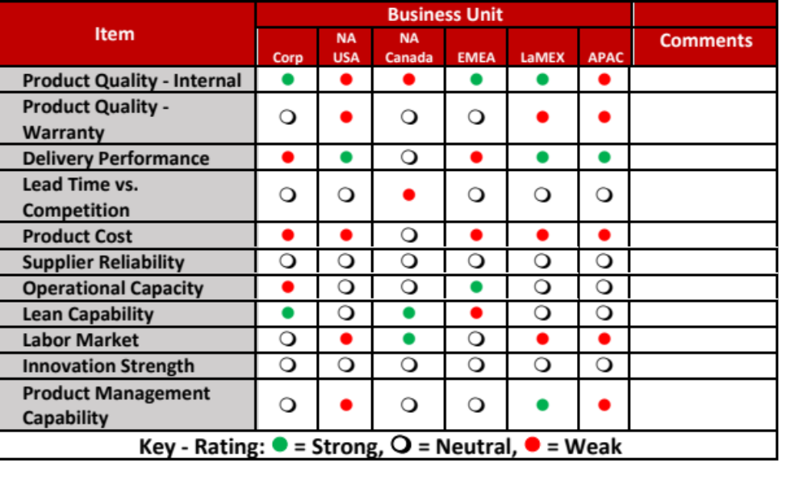
8
Operations & Supply Chain Analysis

Slide 28
8
Operations & Supply Chain Analysis
Key Questions to Consider:
In terms of being a QUALITY supplier, how are you viewed by your customers?
Do you have the future capacity to support your future growth plans?
Can your supply base keep pace with your growth?
Can your suppliers meet your NPD lead-times?
Will geographic expansion require you to reconsider your global footprint?

Slide 29
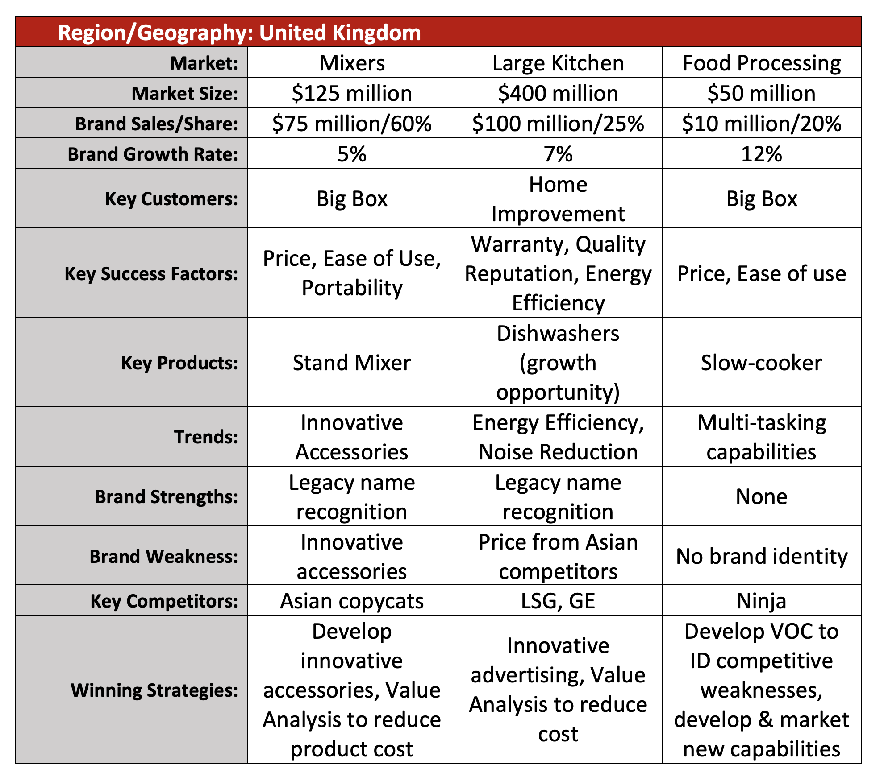
9
Market Analysis
Focus on SERVED Market
Example:
Global tire market includes tires for heavy duty trucks, motorcycles, autos, recreation vehicles, construction equipment, etc.
Not meaningful if you only serve the specialty motorcycle industry

Slide 30
9
Market Analysis

Slide 31
9
Market Analysis
Key Questions to Consider:
Is your focus on your served market?
Are there any markets that you should exit?
What geographical/regional changes will affect your business? (Politics/laws/culture/etc.)
Will new competition enter your markets?
Is the market growing or declining?
Is your share position expected to drastically change?

Slide 32
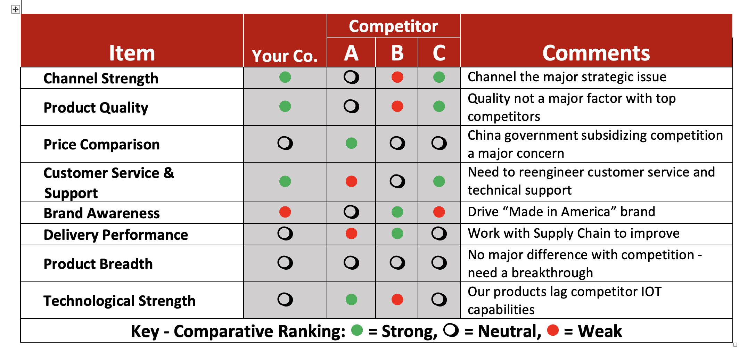
10
Competitive Analysis

Slide 33
10
Competitive Analysis
Key Questions to Consider:
Can you exploit the weaknesses of your competition?
Can you take share by superior Quality & Delivery?
Can you drive price via value-selling efforts?
Does the market understand your competitive strengths?
Do they care?

Slide 34
11
Technological Trends
Defined: Tech Trends that might impact the future of the business.
Competition has developed a lithium battery WIDGET that has wide market appeal. This will require a transition to convert our product line from AC power to a battery-operated platform.
Driver navigation capabilities are being developed in smartphones which will make our stand-alone navigation equipment obsolete.
Cordless table-top appliances are replacing traditional AC-powered products.

Slide 35
11
Technological Trends
Key Questions to Consider:
Can your product/company be displaced via disruptive technology?
Do you have a way to drive effective technology innovations?
Are you driving an adequate % of new products in your annual sales?
Do you have the technical talent (Engineering and Commercial) to keep up with the latest technical needs of the market?

Slide 36
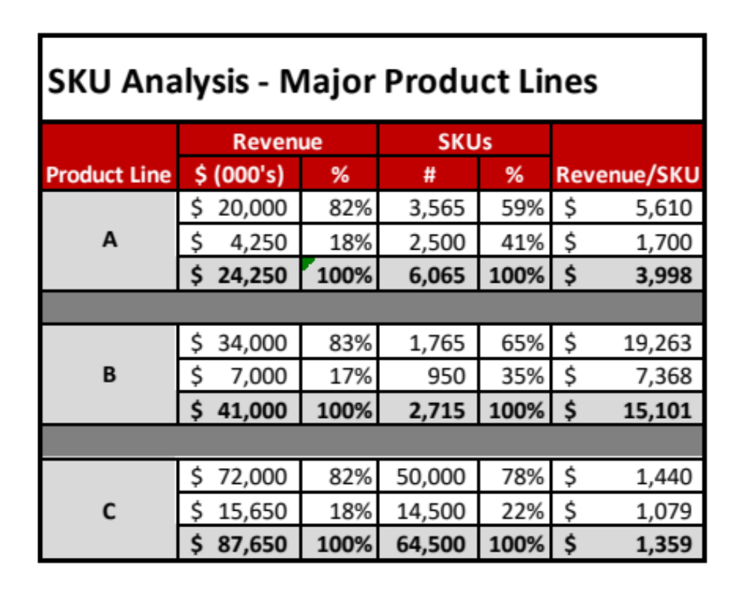
12
SKU Analysis
Provide the # of active SKUs by product line as well as the # of SKUs that make up 80% of your total revenue for that category

Slide 37
12
SKU Analysis
Key Questions to Consider:
Can you pair back redundant SKUs from your product line?
In doing so, how will this be perceived by your customer base?
Are their proper screens in your Product Management process to eliminate SKU overload in your new product pipeline?
Is your salesforce trained and disciplined to sell existing technology?

Slide 38
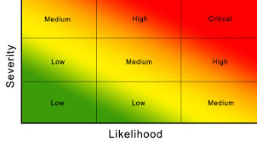
13
Risk Analysis
Key
No Action
Monitor
Mitigate

Slide 39
13
Risk Analysis
Key Questions to Consider:
Do you have a meaningful risk-assessment process?
Do you use FMEA? (Failure Mode Effect Analysis)
Do you consider micro AND macro risks?
Do you have processes on the shelf to mitigate your various risks?

Slide 40
14
Human Capital
Things to Consider:
What training does your current workforce need to meet your strategic plan?
What talent gaps do you have to meet your plan?
    Technical ?
    Commercial?
    Financial?
    Managerial ?
    Leadership?
Do you have a robust talent acquisition process?

Slide 41
15
Financial Summary
Things to Consider:
Profit & Loss Statement
Not a budgeting exercise
Provide 3 Scenarios:
                Upside-Likely-Downside
              Key Metrics to Highlight:
                GM% YOY
                Operating Cash Flow
                CAPEX Spending
                Inventory Turns Projection
                FCF as % of NI
$$$
Balance Sheet
Cash Flow Statement

Slide 42
Introduction
Anatomy of a Strategic Plan
Common Issues with Strategic Planning
Final Thoughts
Agenda

Slide 43

Common Issues and Guidelines
Not telling a story - message is too complex
“How do we win” is not clearly identified
Lack of team buy-in
Lack of prioritization and focus
Too much text, not enough visuals
Improper identification of “Strategic Complexion” (SQDC focus? Growth Focus? Hybrid?)

Slide 44
Introduction
Anatomy of a Strategic Plan
Common Issues with Strategic Planning
Final Thoughts
Agenda

Slide 45

Final Thought
Tell your story…
The quality and clarity of a Strategic Plan is inversely related to the number of pages in the presentation!

Slide 46
Contact Details:
Mark C. DeLuzio
President & CEO
+1.860.234.0915
mark.deluzio@leanhorizons.com
www.leanhorizons.com

